Slide 1

Bazil Housing Data Hackathon

Slide 2
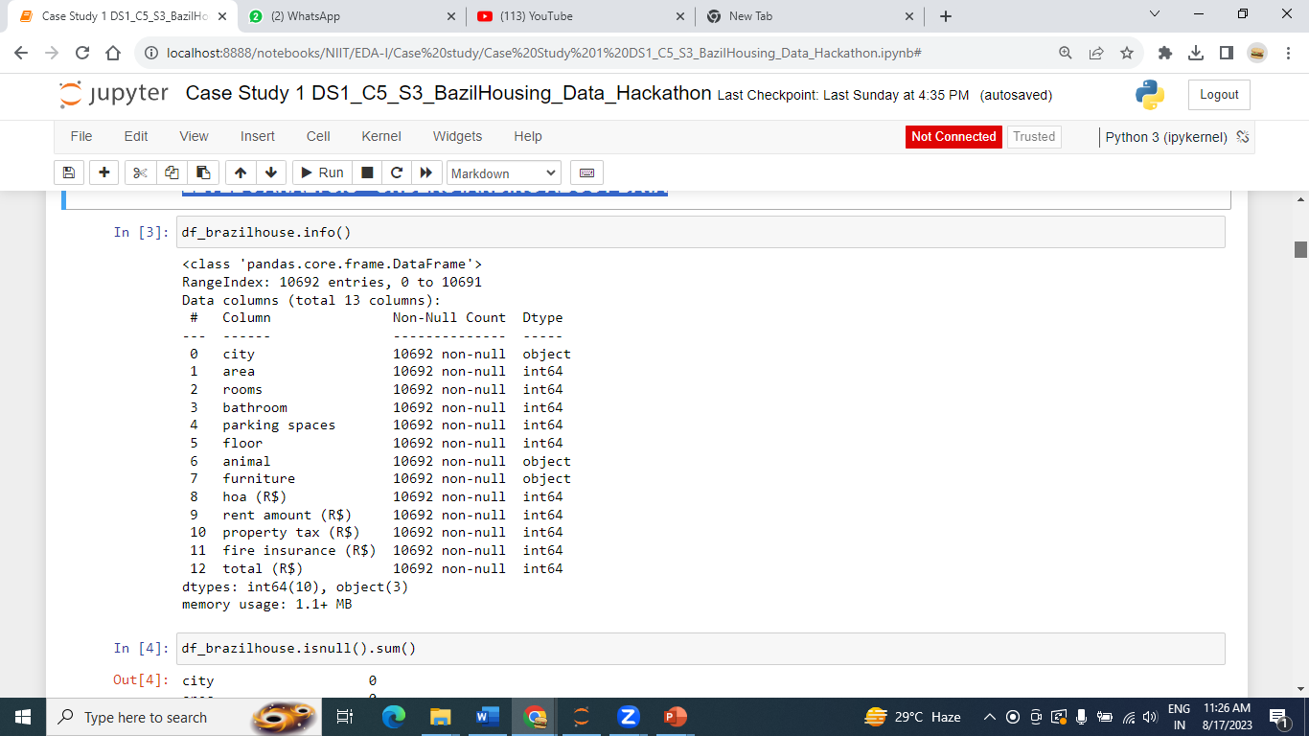
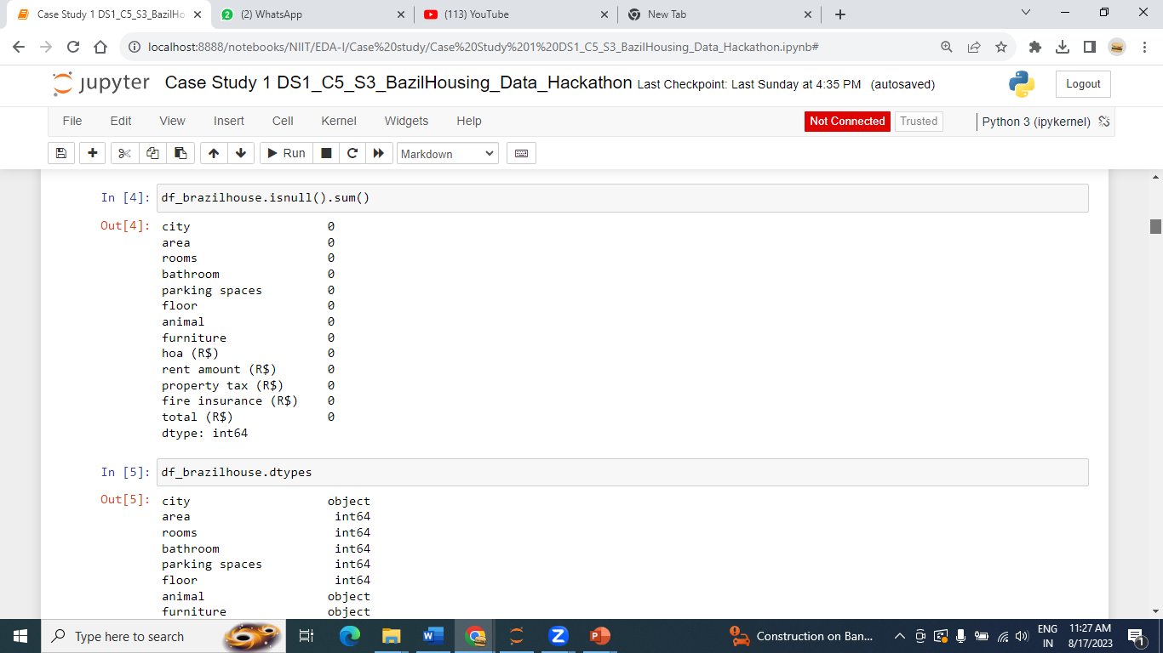

LEVEL 0 ANALYSIS --UNDERSTANDING ABOUT DATA

Slide 3
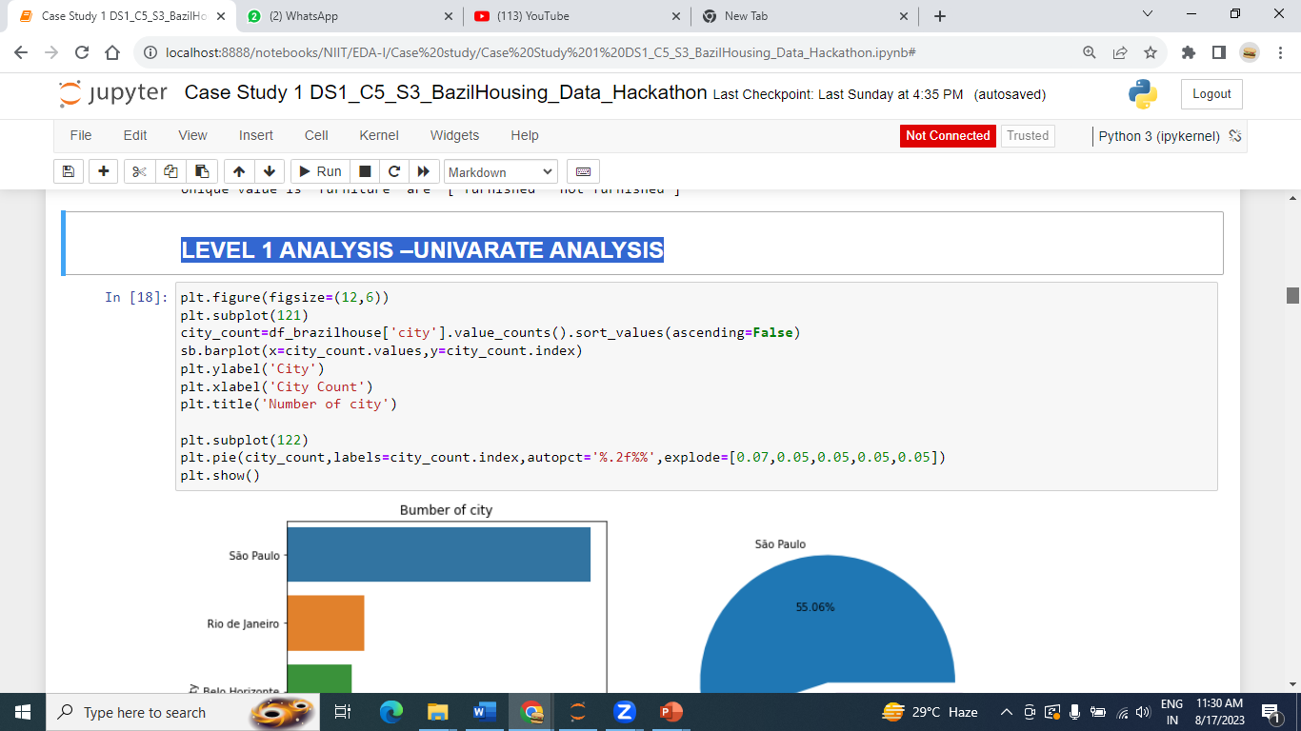
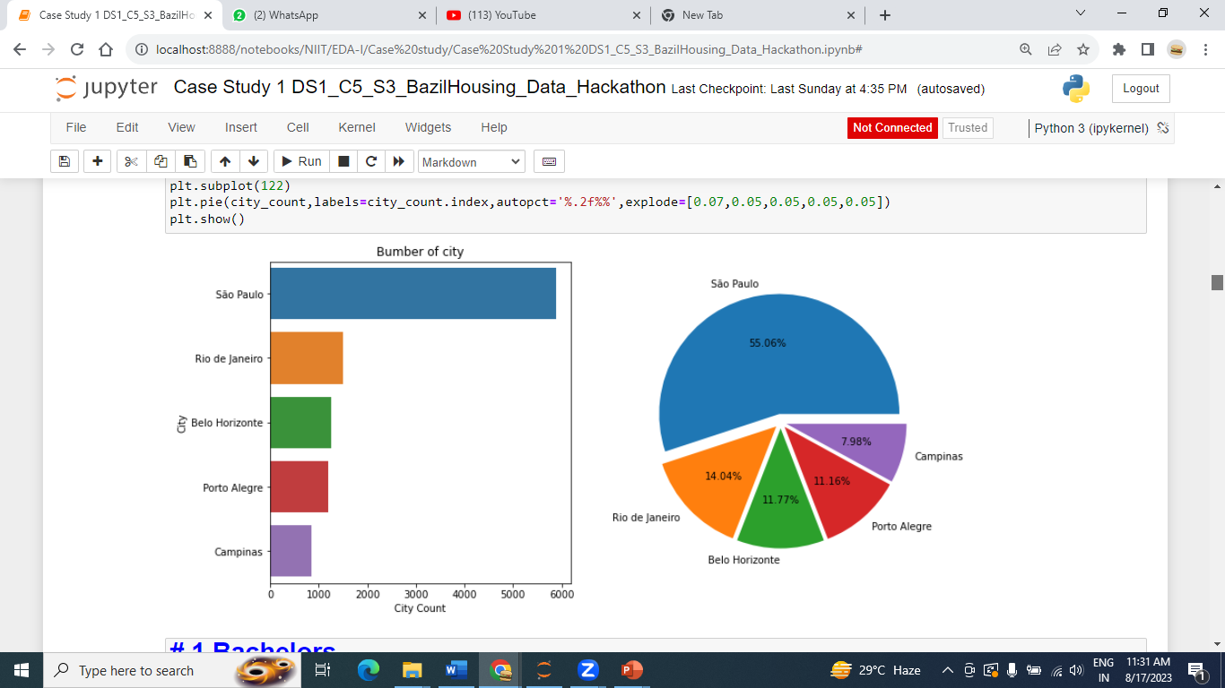
LEVEL 1 ANALYSIS –UNIVARATE ANALYSIS

Slide 4
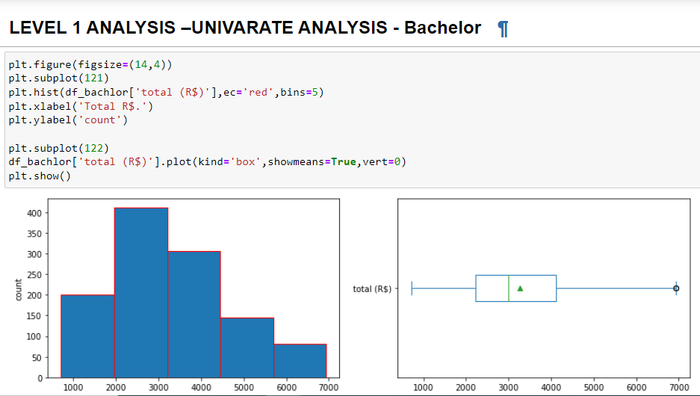

Slide 5
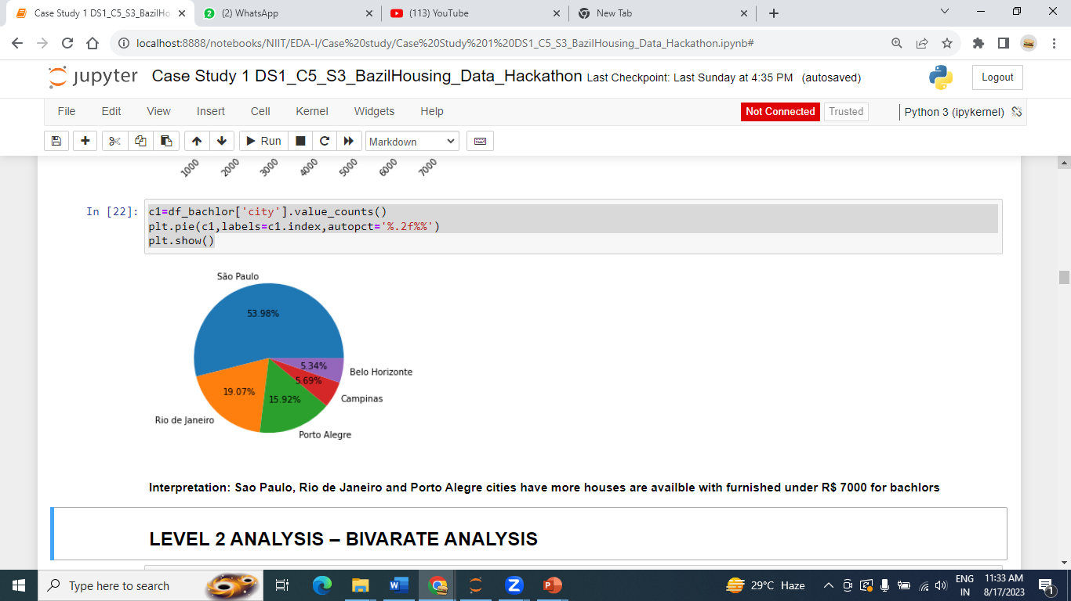

Slide 6
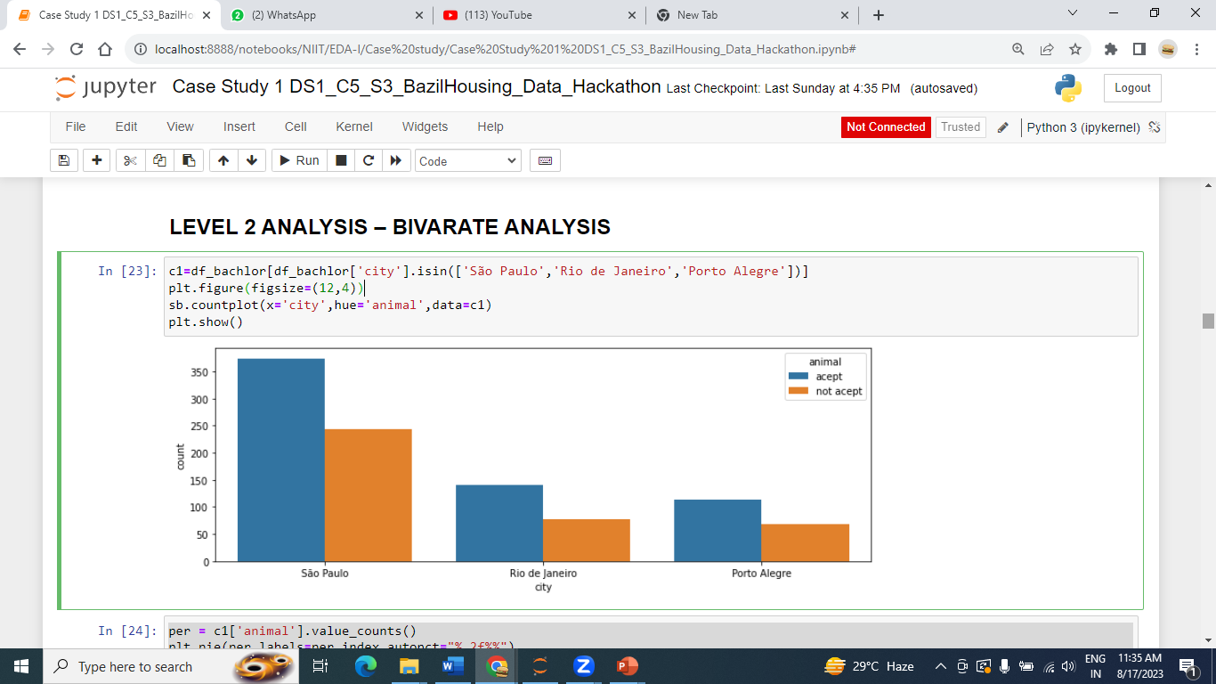
LEVEL 2 ANALYSIS – BIVARATE ANALYSIS

Slide 7
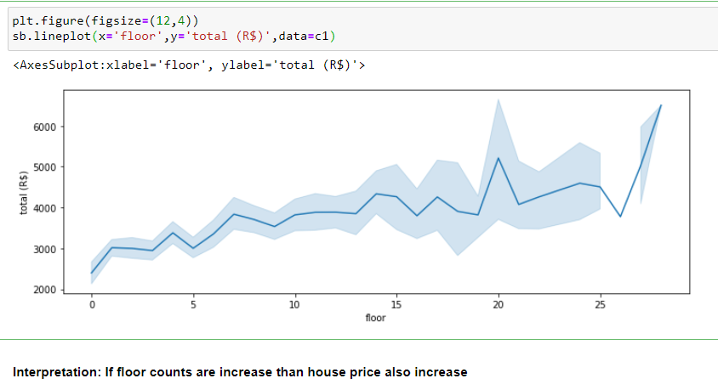

Slide 8
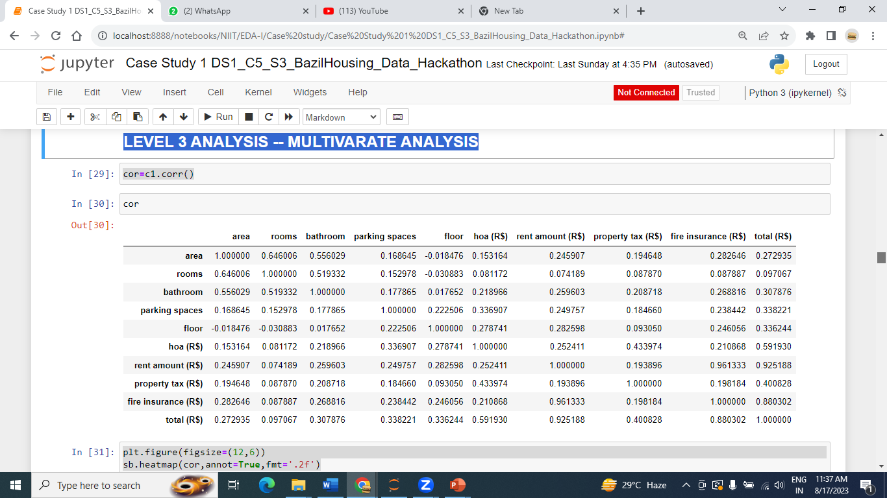
LEVEL 3 ANALYSIS -- MULTIVARATE ANALYSIS

Slide 9
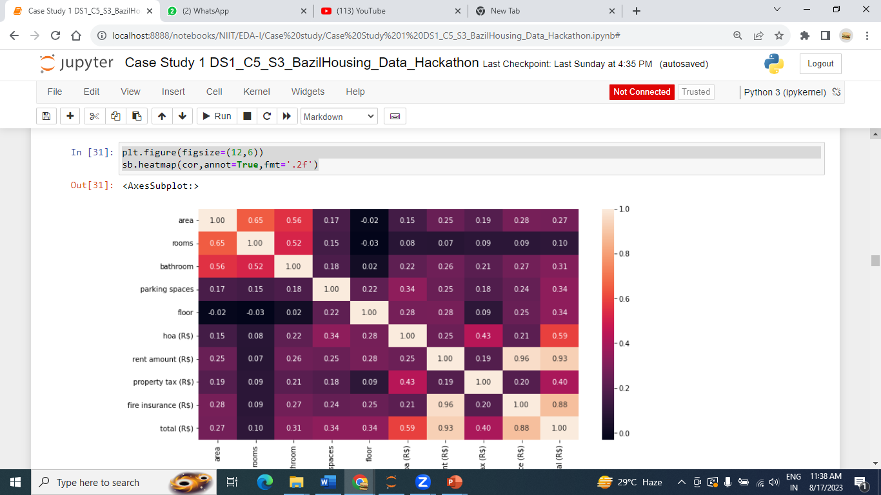

Slide 10
Final conclusion
For bachelors Sao Paulo and Rio de Janeiro cities have more houses are available with furnished under R$ 7000 and animal also allowed.
For Mid-Size family Sao Paulo and Belo Horizonte cities have more houses are available but 80% houses not furnished between Rs. 7000 & Rs.25000 with animal also allowed.
For Large-Size family Sao Paulo has more houses are available but 63% houses not furnished between Rs.25000 & Rs.50000 with animal also allowed.

